Slide 1




Multi-agent modelization for flexibility evaluation in residential dwellings
Autor (intern): Lasha Khubashvili
Supervisors: WURTZ Frederic
Stéphane PLOIX
FlexRICAN

Slide 2

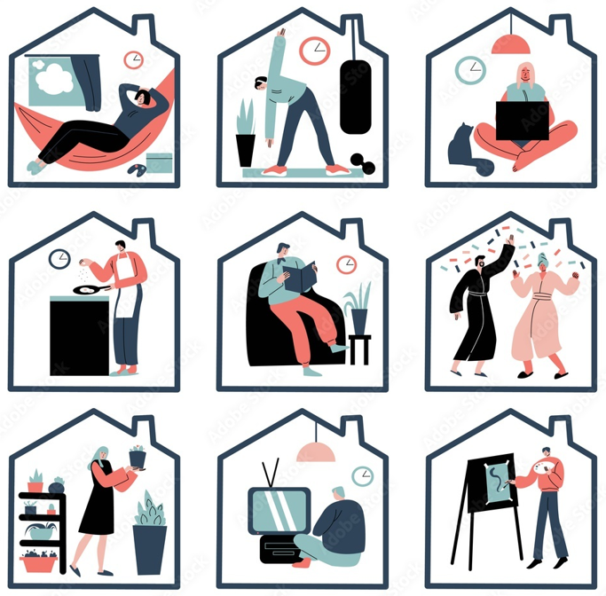
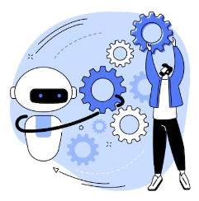
INTRODUCTION
The internship work provides part of the European project “FlexRICAN” collaboration work with 2 laboratories located in Grenoble:
G2ELAB Lab,
G-SCOP Lab.
Under supervision by professors:
Frederic WURTZ & Stéphane PLOIX.
Orientation and Goals
This study focuses on residential buildings, particularly on accurately modeling the actions of households on various signals, that can apply indirect flexibility. We aim to develop a customizable model capable of representing houses and their inhabitants, facilitating the simulation of hypotheses regarding their reactions and consequences.

Slide 4
Different stages of research to Develop Multi-agent simulation
Gathering and processing bibliography and data, which can be useful for research, and finding advanced existing technologies.
Data analysis for the “Irise” database,
Filtering
Collecting important data
Clean data
Categorization for flexible and not flexible devices
Making 2 types of flexibility indicators:
Simple indicators
Complex indicators
Calculate Irise data consumption in different ways:
Annual energy consumption for each device
Devices consumption divided for 24 hours for 1 year to see the daily profile of each device
Flexibility potential calculated with both complex and simple indicators
Simple indicators potential of flexibility
Complex indicators potential of flexibility
Comparison of simple and complex indicators results
First steps of multi-agent simulation simulation. (I can use my picture from board)
Notes:
I filtered data as for one year also I was always filtering data as it was necessary In different scenarios so I applied various filters and methods.

Slide 5
Gathering and processing bibliography and data, which can be useful for research, and finding advanced existing technologies
Keywords clustering
 | Flexibility concept | Flexibility indicators | Multi-agent simulation | Energy Appliances
 | Flexibility | Key performance indicator | Multi Agent-based Smart Home | Energy management system
 | Demand-side management | Flexing residential energy demand indicators | Multi-agent reinforcement learning | application to energy communities
 | Renewable energy | Energy flexibility protocols | Multi-agent systems
 | Building energy flexibility | Flexibility indicators for building
 | Demand response
 | Flexibility characteristics
 | Energy flexibility

Slide 6
Reference | Organization and preferences of references
 | General information | General information | Type
 | Year | Authors | Theoretical | Case oriented | overview
Direct and indirect energy flexibility interactions at the building and community scale: From system to the human-interfaced system | 2024
Human-centered control systems: application to energy communities | 2024
building energy flexibility and demand management | 2023
Data-driven key performance indicators and datasets for building energy flexibility: A review and perspectives | 2023
Flexing the residential energy demand | 2023
Nudging electricity consumption households: A Case study of French residential sector | 2022
Scalable multi-agent reinforcement learning for distributed control of residential energy flexibility | 2022
Energy flexibility of residential buildings: A systematic review of characterization and quantification methods and applications | 2021
A multi-agent system approach to exploit demand-side flexibility in an energy community | 2020
IN-HOME ENERGY FLEXIBILITY PROTOCOLS | 2020
A Literature review on energy flexibility definitions and indicators for building clusters | 2018
Energy flexibility assessment of a multi agent-based smart home energy system | 2017

